Slide 1

Zomato Restaurant Analysis
By Ekta

Slide 2
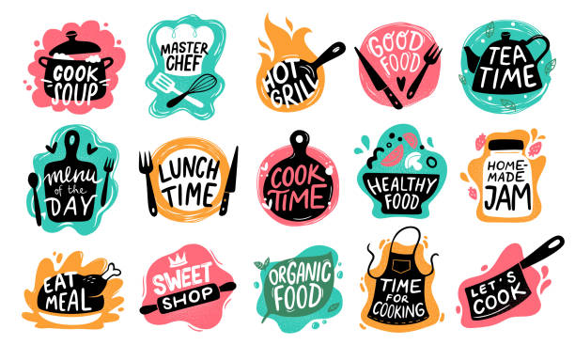

PROBLEM STATEMENT
You are hired as a consultant data analyst by zomato where the team is looking for expansion and opening restaurants. Your task is to come up with strategies/suggestions about opening newer restaurants.

Slide 3
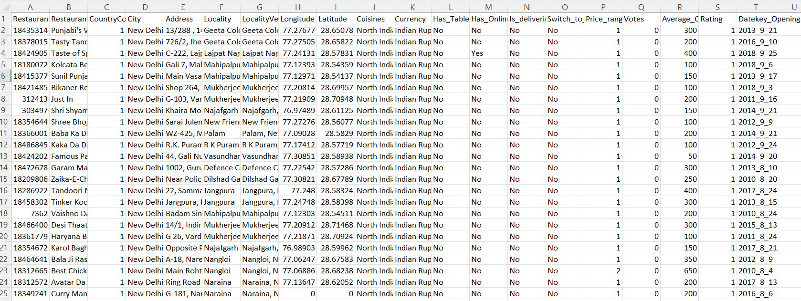
The image below displays details about Zomato Sales Performance

Slide 4
COLUMN DESCRIPTION
Restaurant ID: Unique identifier for each restaurant.
Restaurant Name: The name of the restaurant.
CountryCode: Country code of the location where the restaurant is situated.
City: The city where the restaurant is located.
Address: The specific address of the restaurant.
Locality: The locality or neighborhood where the restaurant is situated.
Locality Verbose: Detailed information about the locality.
Longitude: The geographical longitude coordinate of the restaurant.
Latitude: The geographical latitude coordinate of the restaurant.
Cuisines: The type of cuisine offered by the restaurant.
Currency: The currency used for transactions in the restaurant.
Has_Table_booking: Indicates whether the restaurant has a table booking option (Yes/No).
Has_Online_delivery: Indicates whether the restaurant offers online delivery (Yes/No).
Is_delivering_now: Indicates whether the restaurant is currently delivering (Yes/No).
Switch_to_order_menu: Indicates whether users can switch to the order menu (Yes/No).
Price_range: A numeric value indicating the price range category of the restaurant.
Votes: The number of votes or ratings/(feedback) received by the restaurant.
Average_Cost_for_two: The average cost for two people dining at the restaurant.
Rating: The overall rating of the restaurant is based on user reviews.
Datekey_opening: The date when the restaurant was opened.

Slide 5
ANALYSIS FOR OPENING NEW RESTAURANTS
Countries suitable for opening new restaurants with less competition
Cities suitable for opening new restaurants
Expenditure on food for the suggested countries
Restaurant ratings for the suggested countries
Competitor Analysis
Cuisines to be focused
Online delivery and table booking
Restaurants distributed based on price
Dash board

Slide 6




SUGGESTED COUNTRIES
AUSTRALIA
CANADA
SRILANKA
SINGAPORE
Two factors considered in the selection of countries are :
Average rating : Choosing countries with lower ratings is advantageous for opening new restaurants, as it suggests a dissatisfaction among people with the existing restaurants in those regions.
Less number restaurants leads less competition

Slide 7
CITIES IN SUGGESTED COUNTRIES
AUSTRALIA
CANADA
SINGAPORE
SRILANKA
Aramidale
Balingup
Flaxton
Macedon
Mayfield
Paynsville
Penola
Consort
Yorkton
Singapore
Colombo

Slide 8

EXPENDITURE ON FOOD
Country | Sum of Average_Cost_for_two_in_INR
Australia | 32281.3
Canada | 8992.9
Singapore | 194220.25
Sri Lanka | 12350

Slide 9
Average rating of restaurants in suggested countries
Country | Average of Rating
Australia | 3.658333333
Canada | 3.575
Singapore | 3.575
Sri Lanka | 3.87
The average rating in all the suggested countries is less than 4
By analysing we can confirm that the customers are dissatisfied with restaurants
Implementing innovative concepts, elevating service quality, and customizing offerings to align seamlessly with customer preferences, this proactive approach is designed to not only boost overall customer satisfaction but also secure a distinctive competitive advantage in the market.

Slide 10
Competitors Analysis
Restaurants with less competition
Star buffet
Pier 70
Poets cafe
Consort restaurant
Makansutra guttons bay
Indian elite Restaurant
Queens cafe
Restaurants with medium competition
Three Anchors
Bespoke Harvest
Divine
White bull Hotel
Tokyo sushi
Jaan
Calony
Artistry
Cafe shaze
CIOCONAT Lounge
The Paddington
Malay restaurant
Restaurants with high competition
Bridge road brewers
1918 Bistro & Grill
Vivo bar and Grill
Lake house restaurants
Al’frank cookies
Fratini la trattoria
The sizzle
Butter boutique
Cut by wolf gang puck
Simply strawberries by jagro

Slide 11

Cuisines with high Ratings
cuisines with high ratings among suggested countries
Cuisines
Pizza
Sea food
Mediterranean
Australian
Café
Bar food
American
Steak
Deserts
Modern Australian
The top rated cuisines Sea food, Italian, Pizza.

Slide 12
Online Delivery & Table Booking
Country | Table booking | Online Delivery
Australia | 0 | 0
Canada | 0 | 0
Singapore | 0 | 0
Srilanka | 0 | 0
The recommended countries currently do not provide online delivery and table booking services
Upon entering the market, we can distinguish our brand by providing these services and incorporating a modest convenience fee.

Slide 13
Restaurants based on Price range
Row Labels | Count of RestaurantID
1 | 4444
2 | 3113
3 | 1408
4 | 586
There are 9551 number of restaurants in which
4444 number of restaurants in the range of 1
3113 number of restaurants in the range of 2
1408 number of restaurants in the range of 3
586 number of restaurants in the range of 4

Slide 14
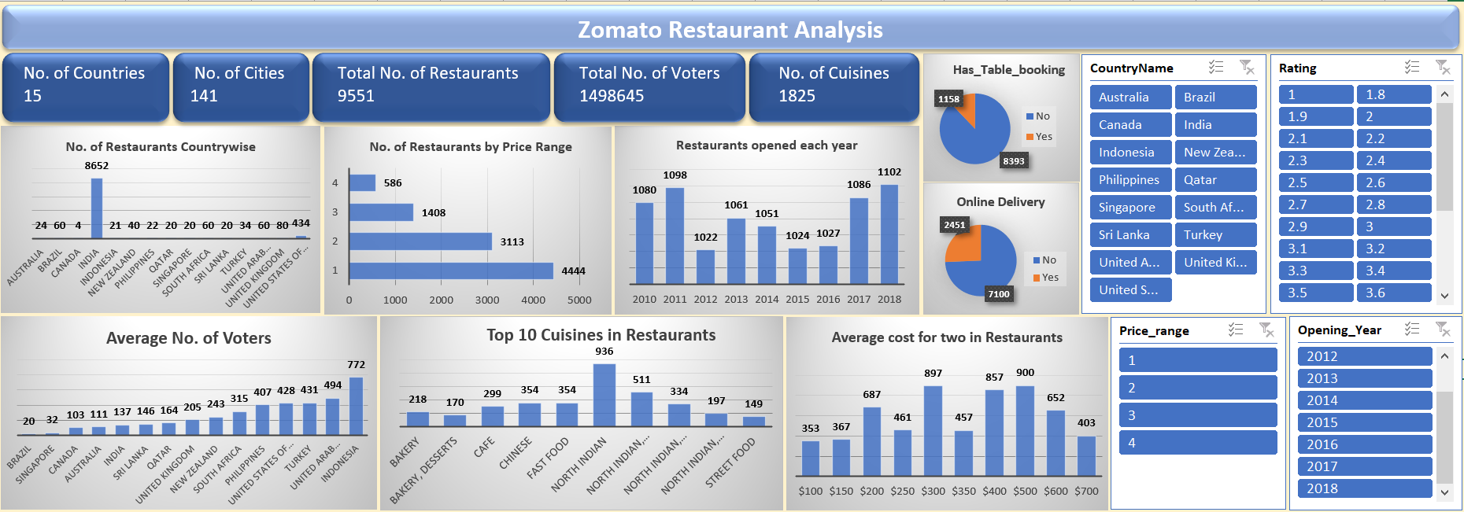
DASHBOARD

Slide 15
CONCLUSION
The analysis on dataset shows countries having the greater number of restaurants, and the services provided by restaurants in different countries and cities like online delivery and table booking.
We identified the most popular cuisines in the area based on the number of restaurants and user ratings.
We examined the correlation between restaurant pricing and customer ratings and found out that the correlation in 0.31 which means restaurant pricing and customer ratings are loosely correlated.
To sum up, Zomato restaurant data research may provide a thorough grasp of the regional eating scene, empowering businesses and other stakeholders to improve consumer experiences, make wise decisions, and take advantage of new trends.

Slide 16
Thank
YOU

